Slide 1



UNIT 4
LESSON 13
Living online
Part 1

Slide 2
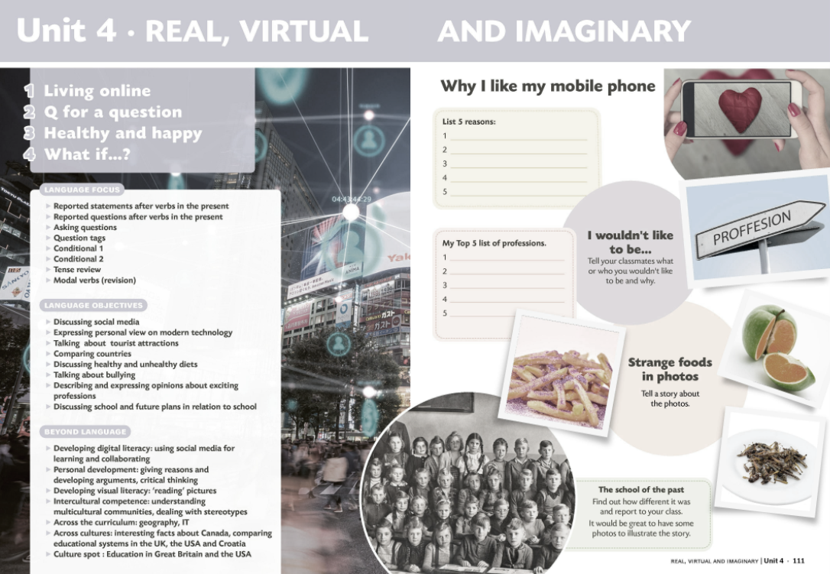



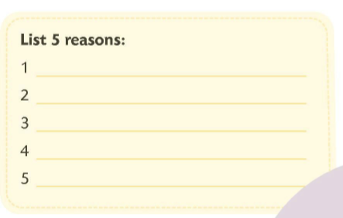
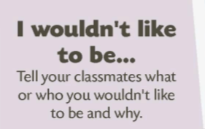

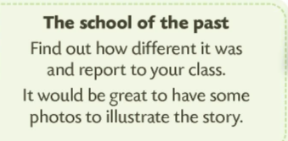
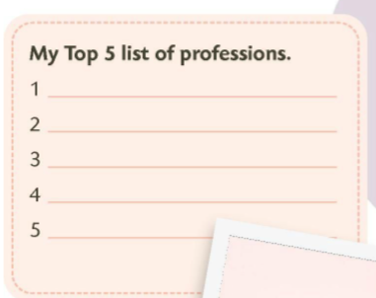

Slide 3


BRAINSTORMING
MODERN GADGETS

Slide 4

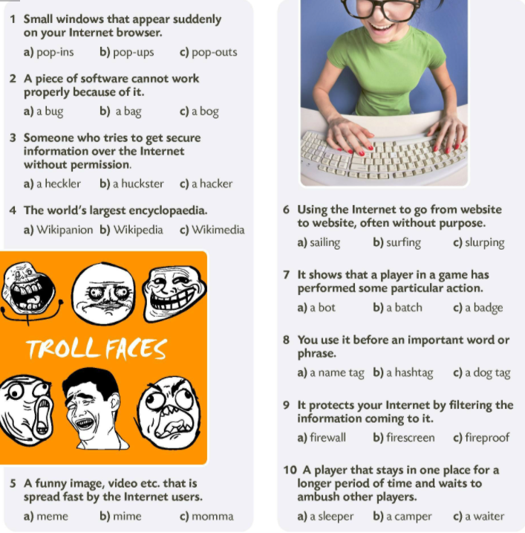



Slide 5
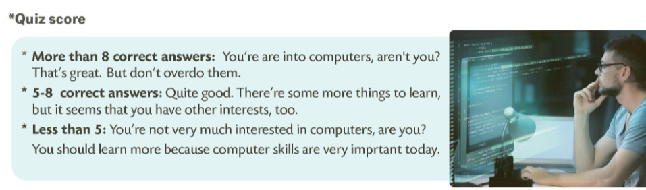
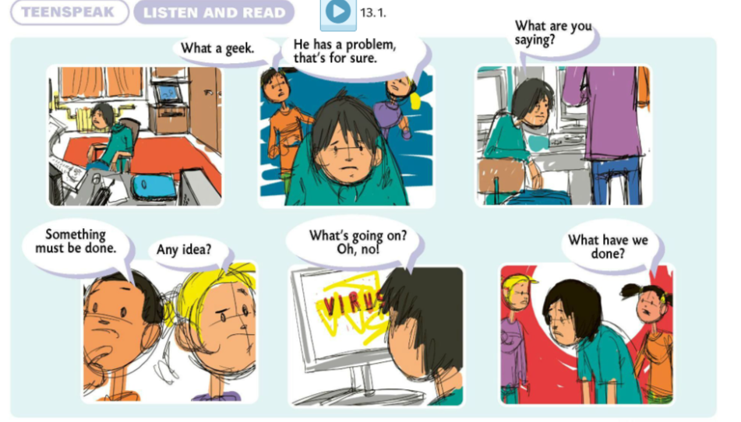

What a geek!

Slide 6
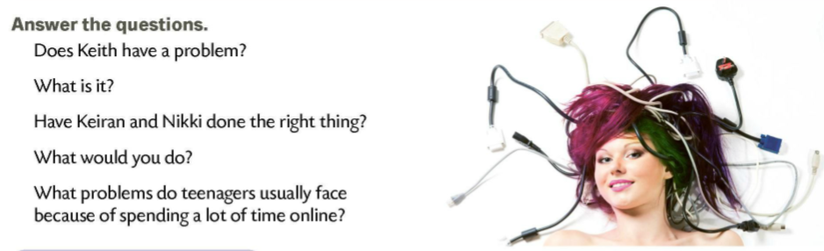
Choose one of the words/expressions (in your notebook or in the book) and write a sentence about it on a piece of paper. Then put your name on it. Share sentences using Linoit board (or a similar virtualn board). LINOIT
E.g.
I hate texting. (Sandra)
I think texting is stupid. (Nikola)
I never download music. (Mirna)
Sandra says that she hates texting.
Nikola thinks that texting is stupid.
T: Mirna says that she never downloads music.
M: No, I often download music.
T: Sorry. Mirna says that she often downloads music.

Slide 7
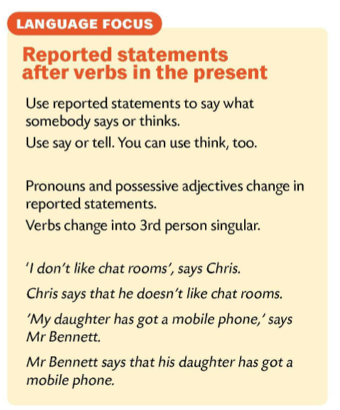
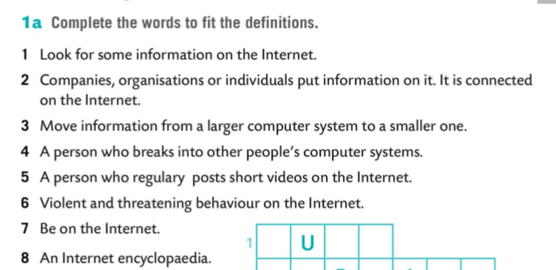
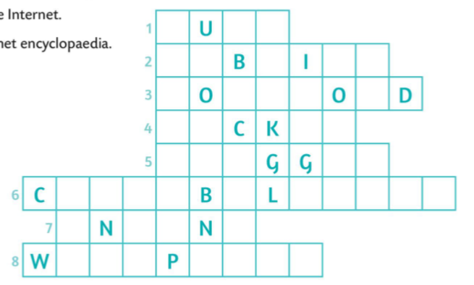
surf
website
download
hacker
vlogger
cyberbullying
online
Wikipedia

Slide 8
